Slide 1




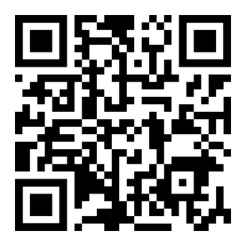
March 20, 2025
11 AM - 2 PM
Snyder MBC
701 Westmont Dr.
TO PURCHASE TICKETS:
FAOIAM.ORG/BNB
OR SCAN HERE:
Proceeds benefit the ministry of
Fayetteville Area Operation Inasmuch
Free Delivery on 10 or More Orders!

